Slide 1
Hyperplanes
Aum Sri Sairam

Slide 2
Space Dimension (d) | Hyperplane Shape | Hyperplane Dimension
1D | Point | 0
2D | Line | 1
3D | Plane | 2
4D | 3D Volume | 3
d | d-1 Dim Obect | d-1

Slide 3
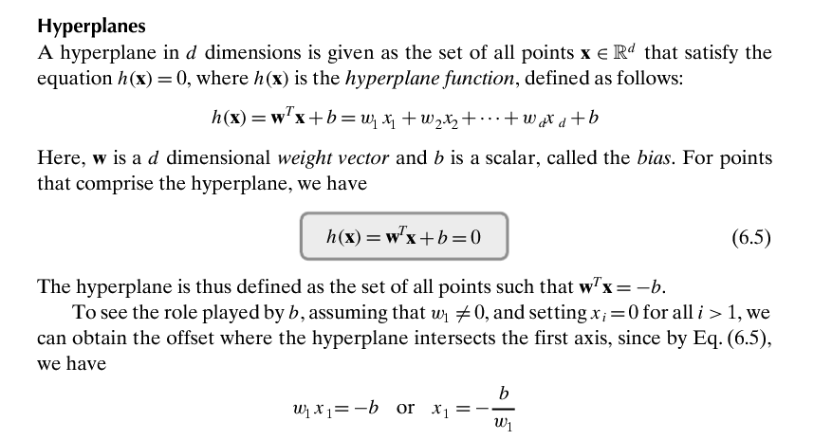

Slide 4
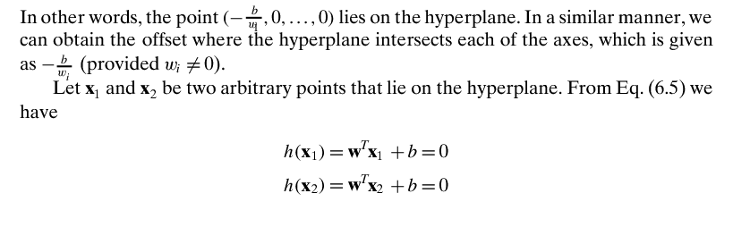
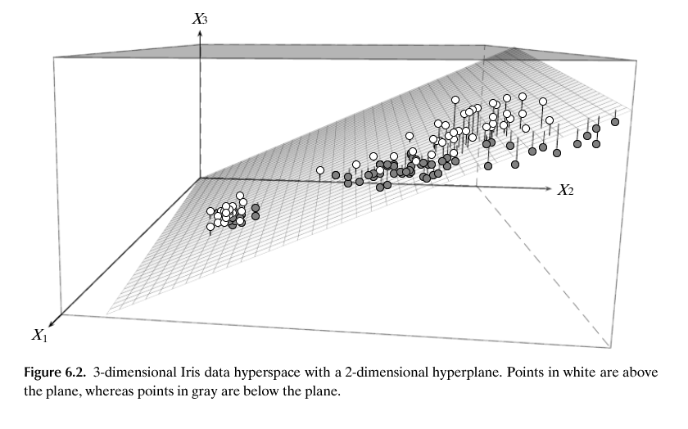


Slide 5
